Slide 1
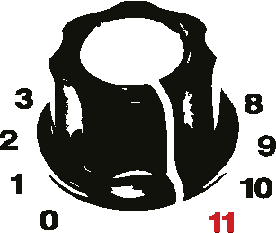
JRuby & TorqueBox
Web, and Workers, and Clusters, Oh My

Slide 2
Who am I?
Chris Meadows
Principle Software Engineer & Architect
Signal Mountain Software, LLC
Email: chris@signalmountainsoftware.com
Twitter: @meadoch1
1996-2013 Professional application development with most all the buzzwords
February 2012 – today: Ruby development

Slide 3
Credit where Due!
Joe Kutner – Deploying with JRuby, @codefinger

Slide 4
Agenda
Why JRuby?
Using JRuby
Moving to JRuby
Why TorqueBox?
What’s in it?
Moving to TorqueBox
Q&A

Slide 5
What is JRuby?
“The Ruby Programming Language on the JVM”
- From jruby.org

Slide 6
Background
Started in 2001 (Ruby 1.6)
2004 the current core team began
July 2009 core team moved from Sun to Engine Yard
May 2012 some went to Red Hat
Main devs:
Thomas Enebo
Charles Nutter
Nick Sieger
Active development sponsored by Red Hat and Engine Yard

Slide 7
What is JRuby?
JRuby
Parser
Core
Classes
Java
Integration
Bytecode
JIT
JVM
Threads
GC
Native
JIT
C API
adapted from Charles Nutter - Euroko2012

Slide 8
So what?
Real Threads
No GIL
A Seasoned JVM
Rich Ecosystem
“Enterprise Approval”
Rich Security Model
and more

Slide 9
What are the downsides?
No Ruby 2.0 (yet)
Slower spin up times
No gems requiring native extensions
No GIL => Thread safety concerns
Possibly more resource demanding
Should have (or get) JVM knowledge

Slide 10
Using JRuby
Disclaimer!
Notes:
Developer Productivity
Pervasive Conventions
Less code required
Elimination of boilerplate*
Easy Development of Complex Web Apps
Long lived states
Very different flow than request/response

Slide 11
Using JRuby
Installation
Native packages
rvm
source

Slide 12
Using JRuby
Like you're used to...kind of
ruby → jruby
irb → jirb
bundle → jruby -S bundle
(or rvm handles the switch/aliasing for you)

Slide 13
Using JRuby
Command Line
jruby -S gem install rails
-S argument runs Jruby's version of the gem binary

Slide 14
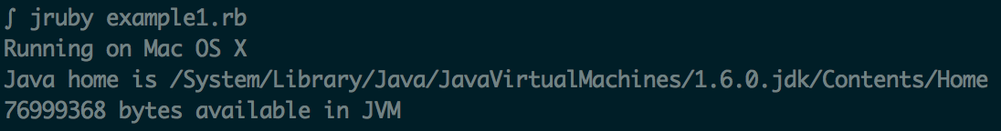
Using JRuby
Command Line
require 'java'
os = java.lang.System.get_property 'os.name'
home = java.lang.System.get_property 'java.home'
mem = java.lang.Runtime.get_runtime.free_memory
puts "Running on #{os}"
puts "Java home is #{home}"
puts "#{mem} bytes available in JVM"
# From Using JRuby; Nutter, et al; Pragmatic Press

Slide 15
And now for something completely different…

Slide 16
Example Application
Really basic web site with Users
Users
have email and name
Requirements:
Email welcome to new users
Send random user a solicitation message occasionally
Receive messages from an external system through RabbitMQ

Slide 17
Now back to your regularly scheduled program

Slide 18

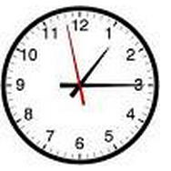
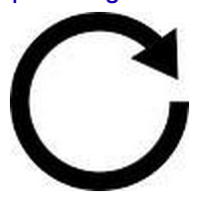





Life of a Typical Rails App
Ref: nginx.org, phusionpassenger.com, rubyonrails.org, sidekiq.org, redis.io

Slide 19

Life of a Typical Rails App
Ref: nginx.org, phusionpassenger.com, rubyonrails.org, sidekiq.org, redis.io, rabbitmq.com

Slide 20
TorqueBox
“TorqueBox is a new kind of Ruby application platform...
provides an all-in-one environment, built upon the latest
JBoss AS Java application server and Jruby.”
– torquebox.org

Slide 21
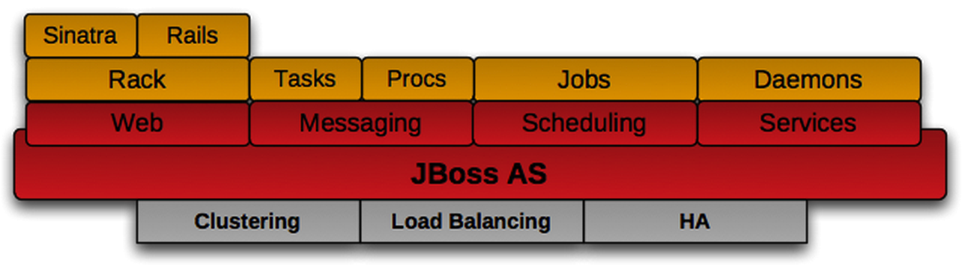
TorqueBox
from torquebox.org

Slide 22
TorqueBox
What's Inside?
Web – Jboss AS, Coyote
Background workers – threads
Messaging – JMS, HornetMQ (STOMP)
Scheduling – Quartz
Caching - Infinispan

Slide 23
TorqueBox
How do I get it?
gem install torquebox-server
Binary or source installs
http://torquebox.org/download

Slide 24
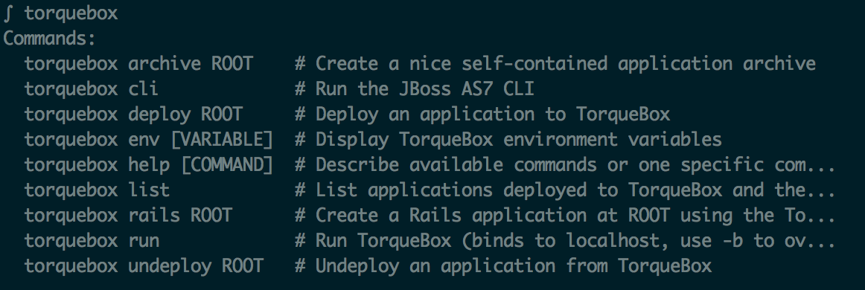
TorqueBox
Commands

Slide 25
TorqueBox
How do I use it?

Slide 26
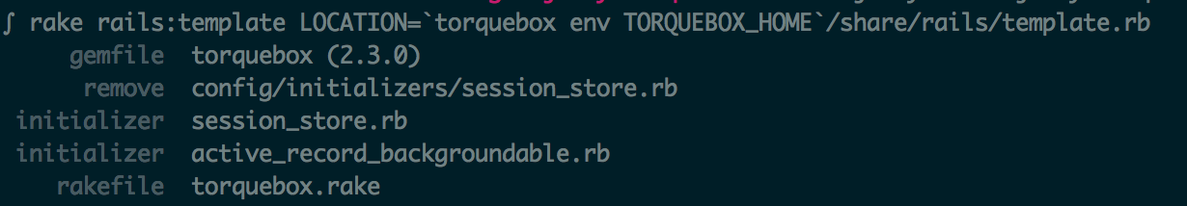
TorqueBox
Usage
Existing App
  jrlint
  jdbc
New App
  rails new test1
gem install torquebox-server rails
rake rails:template \
LOCATION=`torquebox env TORQUEBOX_HOME`/share/rails/template.rb

Slide 27
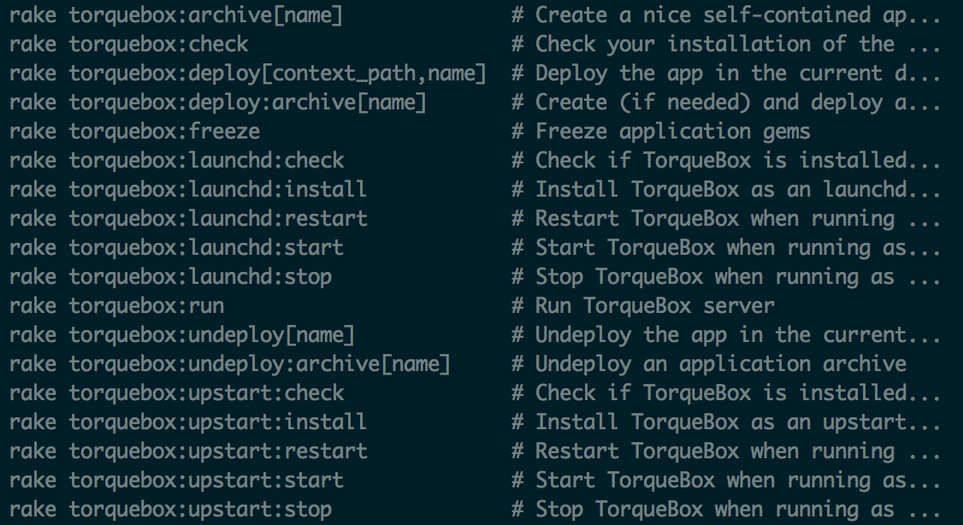
TorqueBox
Usage
rake

Slide 28
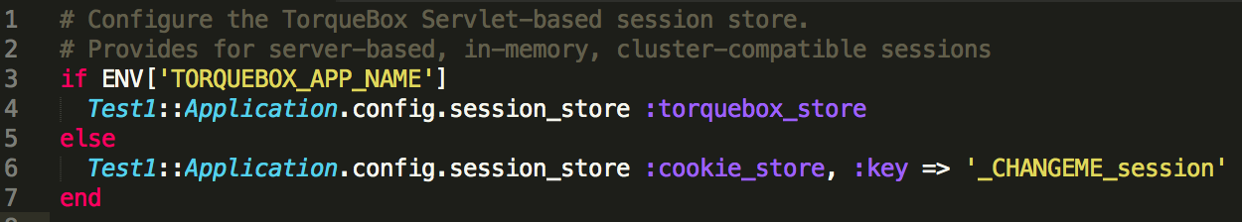
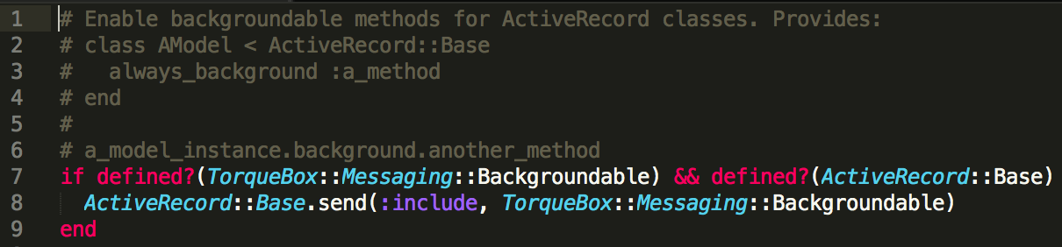
TorqueBox
Usage
session_store.rb
active_record_backgroundable.rb

Slide 29
TorqueBox
Usage – Kick the tires
Deploy
Backstage
(remember to show amazing demo)

Slide 30
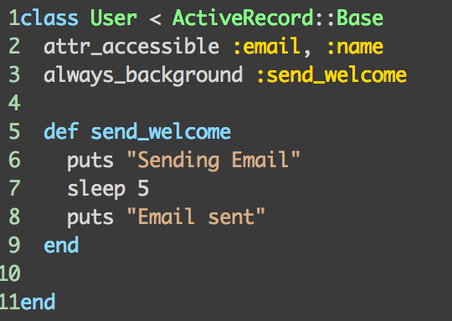
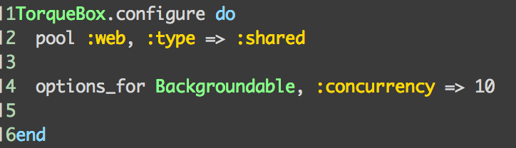
TorqueBox
Usage – Background Work
Backgroundable
app/models/user.rb
config/torqeubox.rb

Slide 31
TorqueBox
Usage – Background Work
Message Processors
Utilizes HornetMQ to distribute work

Slide 32
Messaging Aside
Common Messaging Patterns
Request – Reply
Competing Consumer
Pub / Sub

Slide 33
Messaging Aside
Request - Reply
Message Exchange
Client
Request
Queue
Message Processor
Queue
Reply

Slide 34
Messaging Aside
Competing Consumer
Message Exchange
Consumer
Publisher
Queue
Consumer
Consumer
Only one consumer receives a given message
“first come, first served”

Slide 35
Messaging Aside
Pub/Sub
Message Exchange
Topic
Subscriber
Publisher
Subscriber
Subscriber
One message is copied to many subscribers/consumers

Slide 36
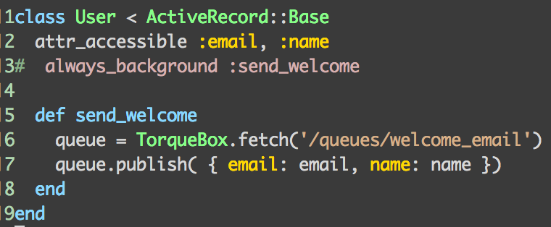
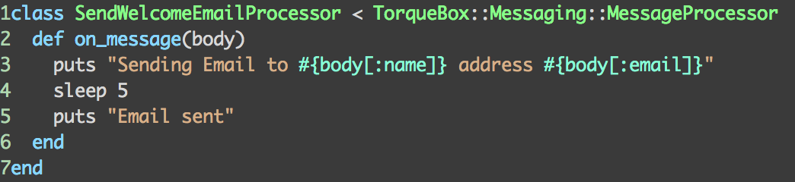
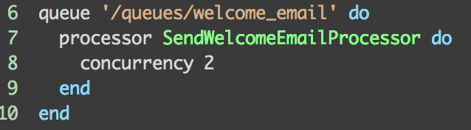
TorqueBox
Usage – Background Work
Message Processors
app/models/user.rb
app/processort/send_welcome_email_processor.rb
config/torqeubox.rb

Slide 37
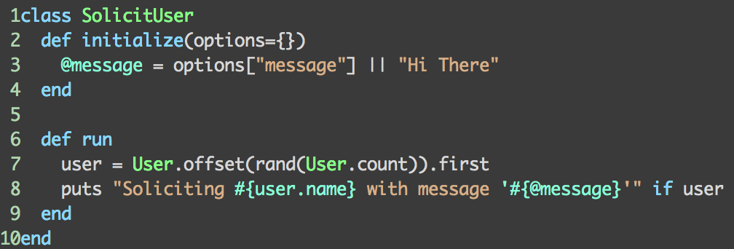
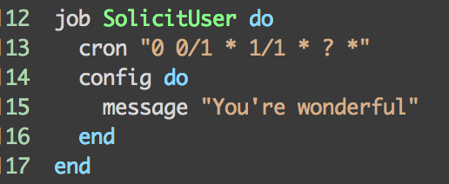
TorqueBox
Usage – Scheduled Jobs
app/jobs/solicit_user.rb
config/torqeubox.rb

Slide 38
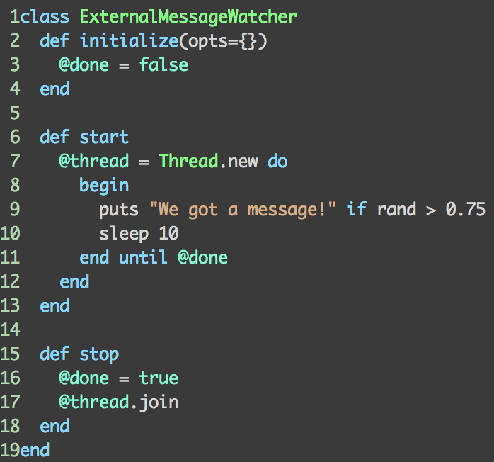
TorqueBox
Usage – Scheduled Jobs
app/services/external_message_watcher.rb
config/torqeubox.rb

Slide 39
TorqueBox
Usage – Stomplets
No time to demo (sorry)
Uses WebSockets to push to client
Client JavaScript subscribes to a queue
Server pushes messages to the queue
TorqueBox includes a JS library that enables the Client side functionality

Slide 40
TorqueBox
Usage – Clustering
Uses Multicast to recognize and coordinate
Can be manually configured via XML
Web load balancing via Apache mod
Distributed Cache
Replicates Jobs, Services, & Processors
Allows Singletons by configuration
Automatically fails over and replicates when a node goes down
Watch Demo

Slide 41
TorqueBox
Usage – Deployment
Knob file
Push files with Capistrano
Git repo with StompBox

Slide 42
Questions?

Slide 43
More info
Dig into torquebox.org for more depth
Deploying JRuby, Joe Kutner, Pragmatic Press
I’d be glad to talk
Chris Meadows
chris@signalmountainsoftware.com
@meadoch1 (Twitter)
https://github.com/meadoch1/tbapp

